Slide 1
Bank Marketing Campaign Prediction
Name: Xiaoying Yang
Email: xiaoyingyy97@outlook.com
Country: United States
College: University of Illinois at Urbana Champaign
Specialization: Data Science

Slide 2
Content
Introduction
EDA
Feature Engineering
Modelling
Results and Conclusion

Slide 3
Introduction
Problem description
ABC Bank wants to sell its term deposit product to customers and before launching the product they want to develop a model which help them in understanding whether a particular customer will buy their product or not (based on customer's past interaction with bank or other Financial Institution).
Github Repo link
https://github.com/Shinuing/Bank-Marketing-Campaign-Prediction

Slide 4
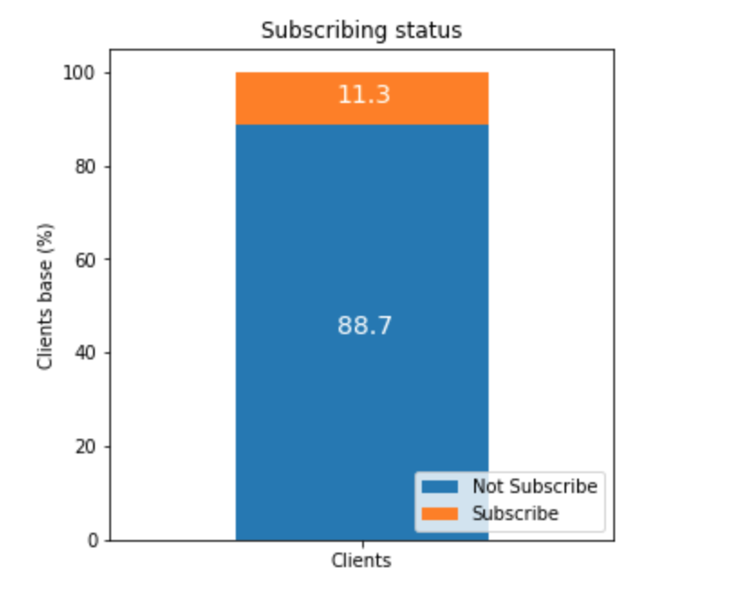
EDA - subscribing
Around 11% clients subscribe, make sense

Slide 5
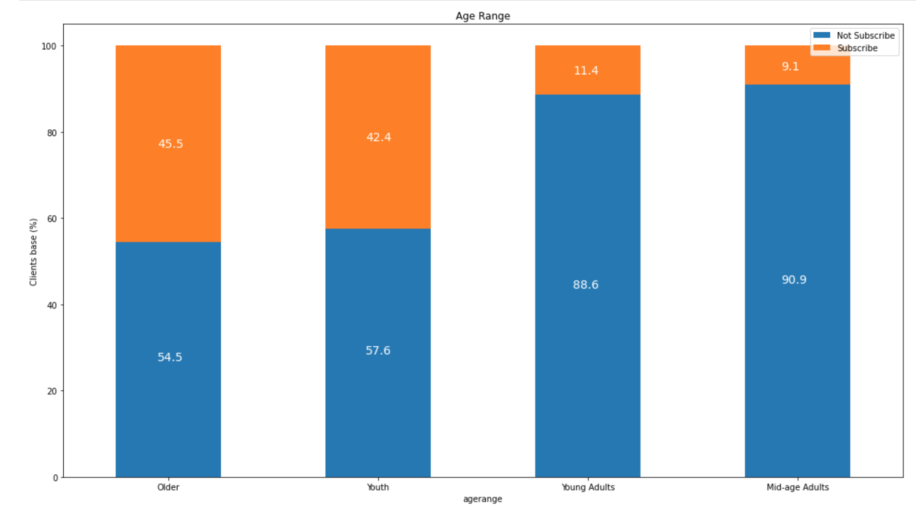
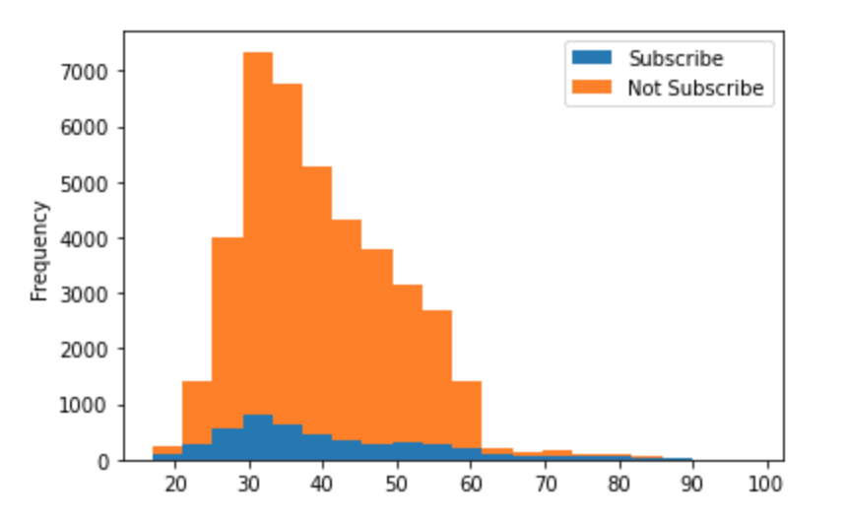
EDA – client age
older people and youth are more likely to subscribe

Slide 6
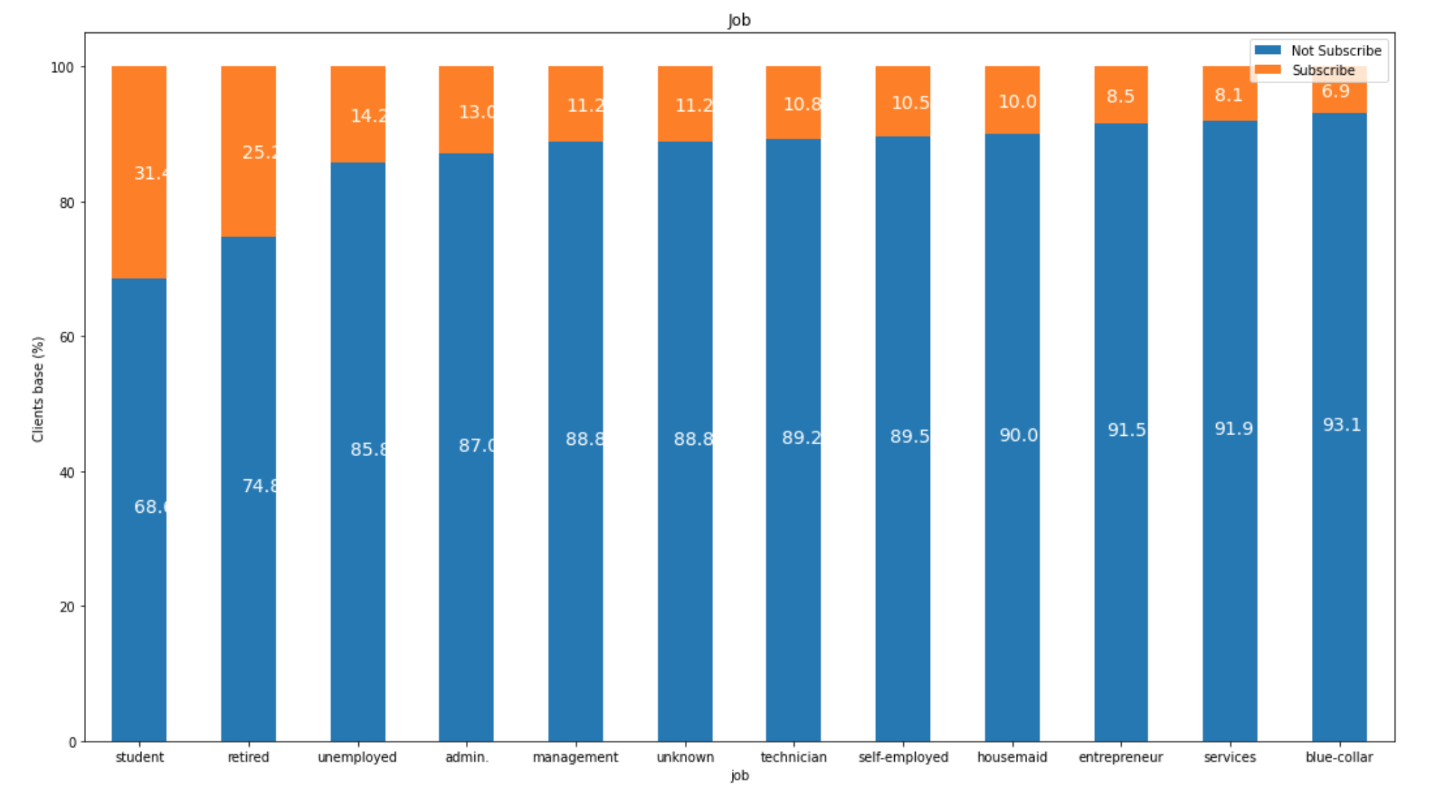
EDA – client job
similar to age variables, students and retired are more likely to subscribe

Slide 7
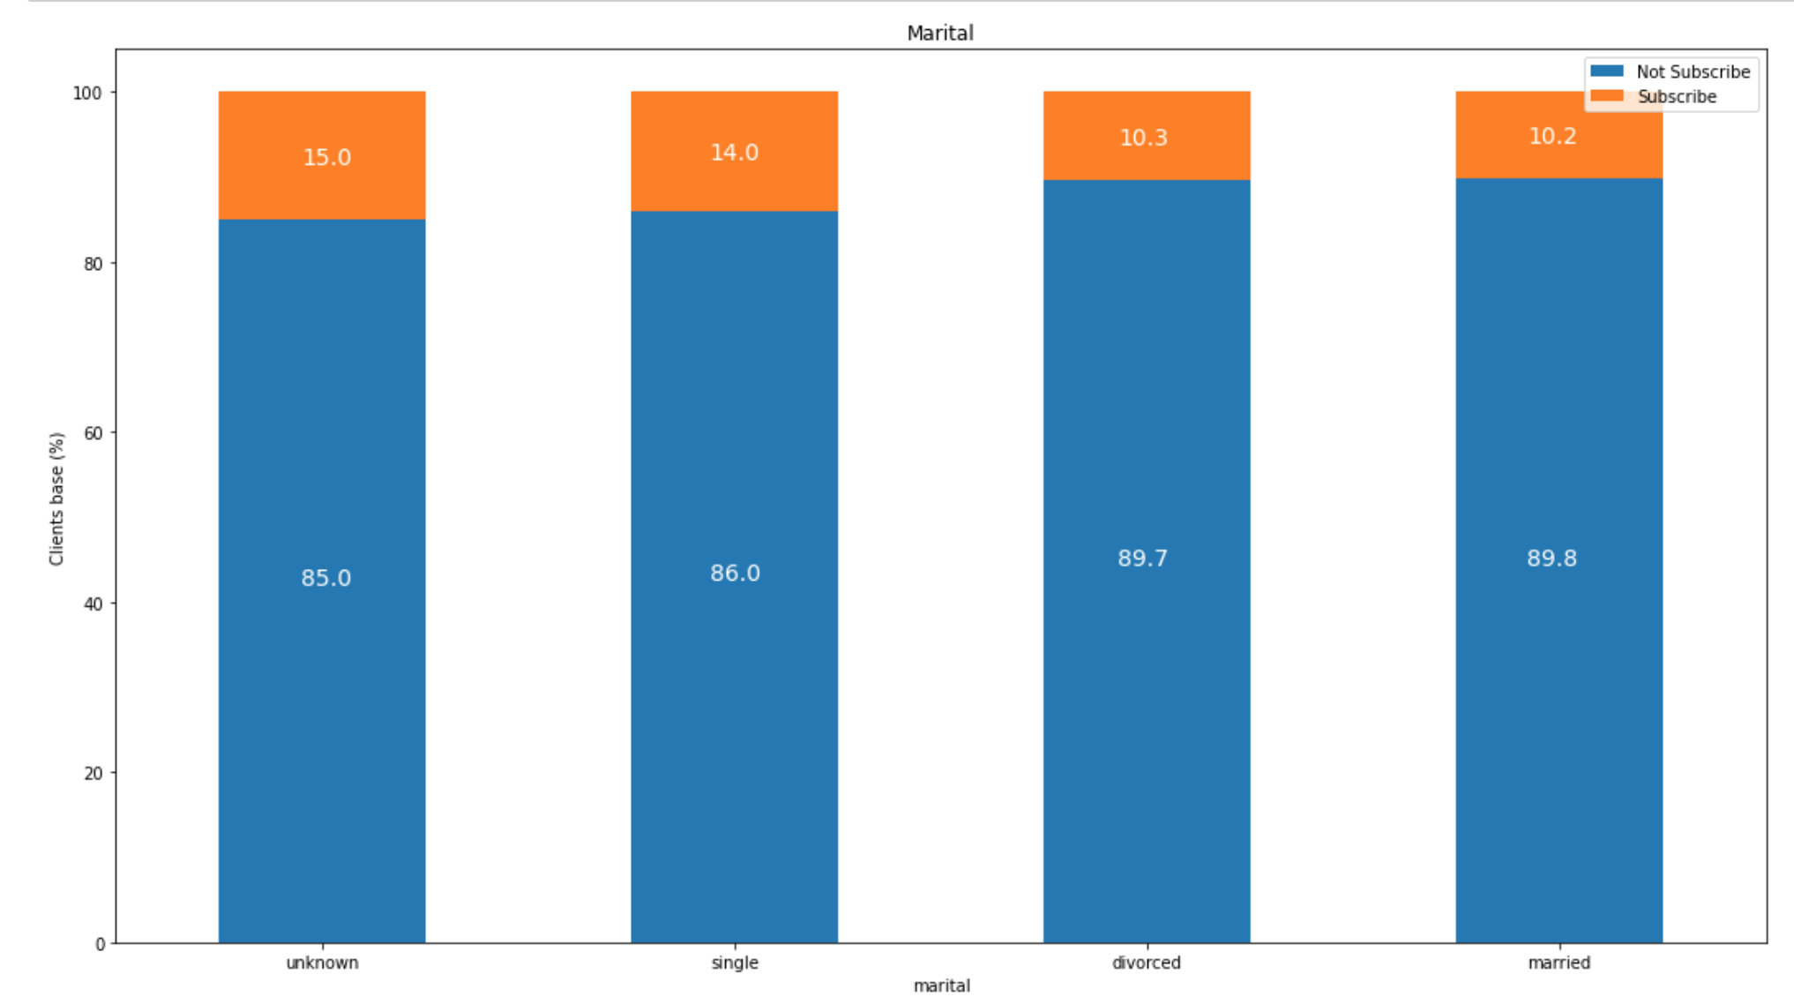
EDA – client marital
similar rate
noticed that unknown is more likely to subscribe

Slide 8
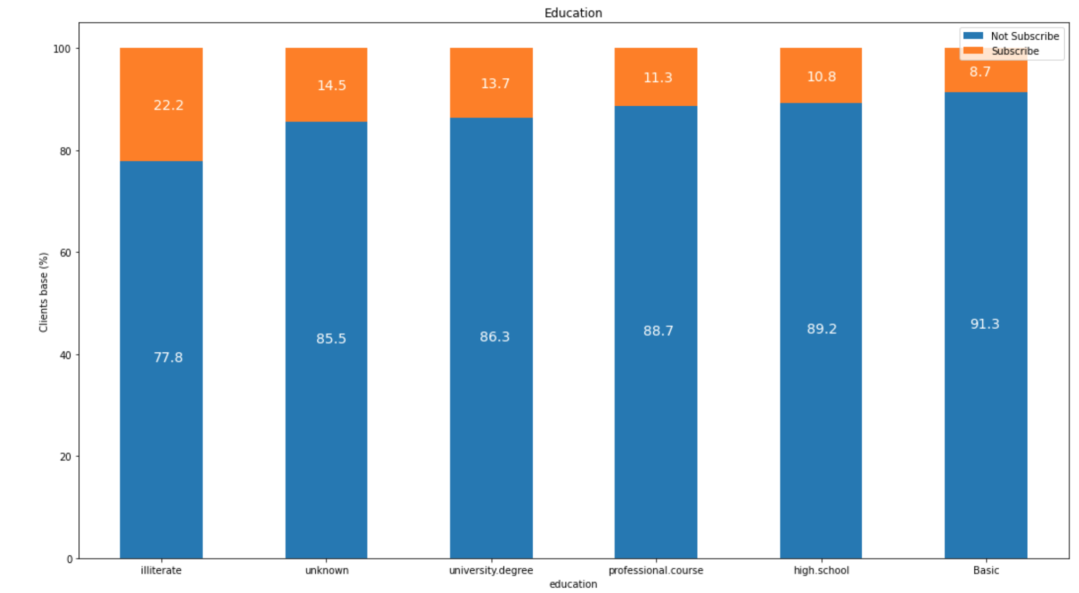
EDA – client education
illiterates are more likely to purchase, probably they earn more money?
note that unknowns are also likely to subscribe

Slide 9
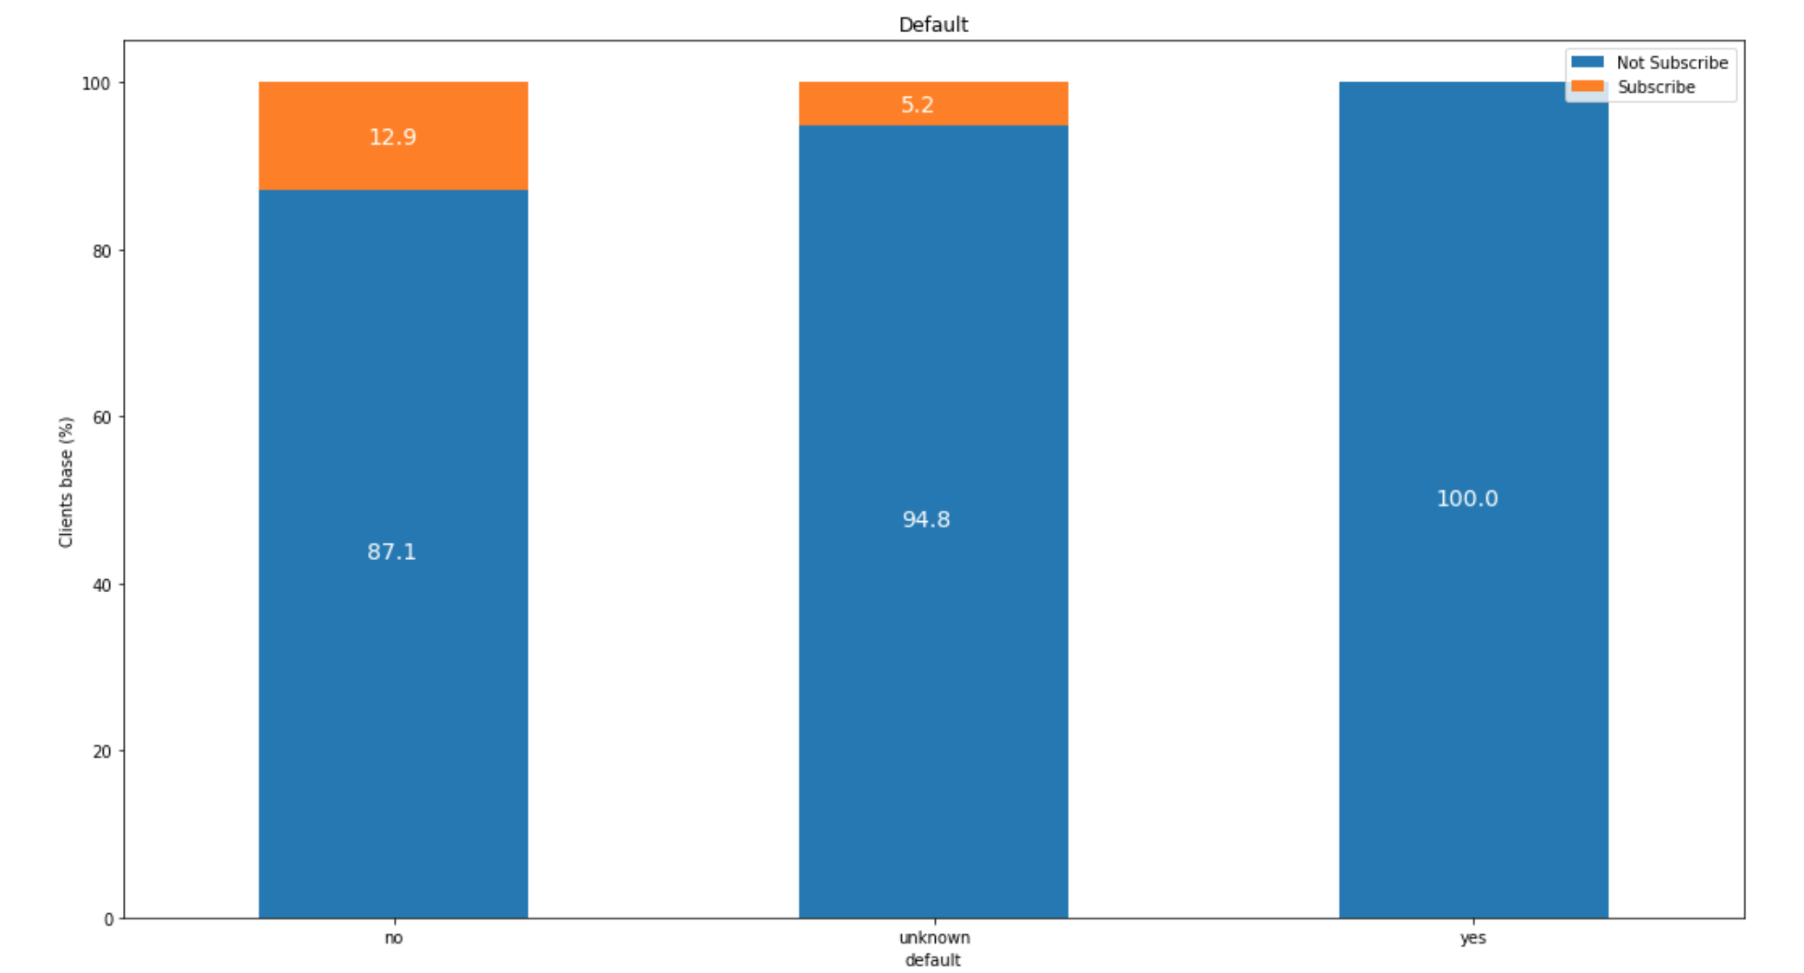
EDA – default
clients who has confirmed credit has NO subscribe at all
No credits are more likely to subscribe

Slide 10
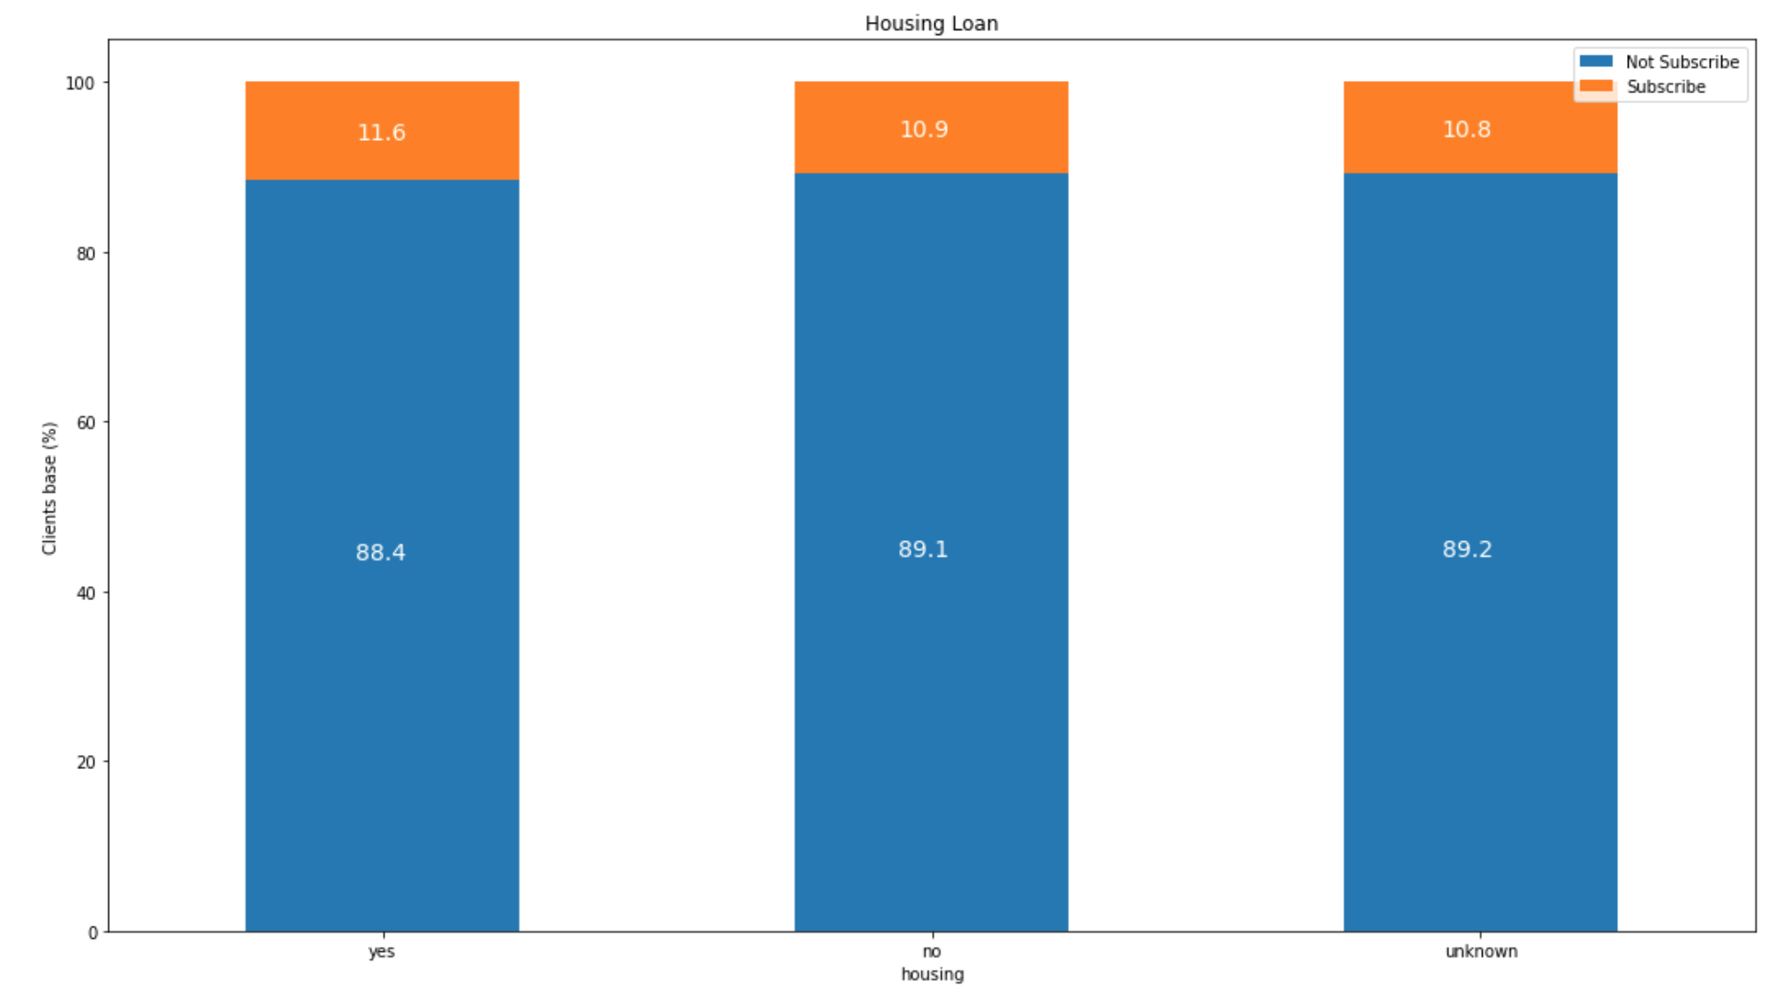
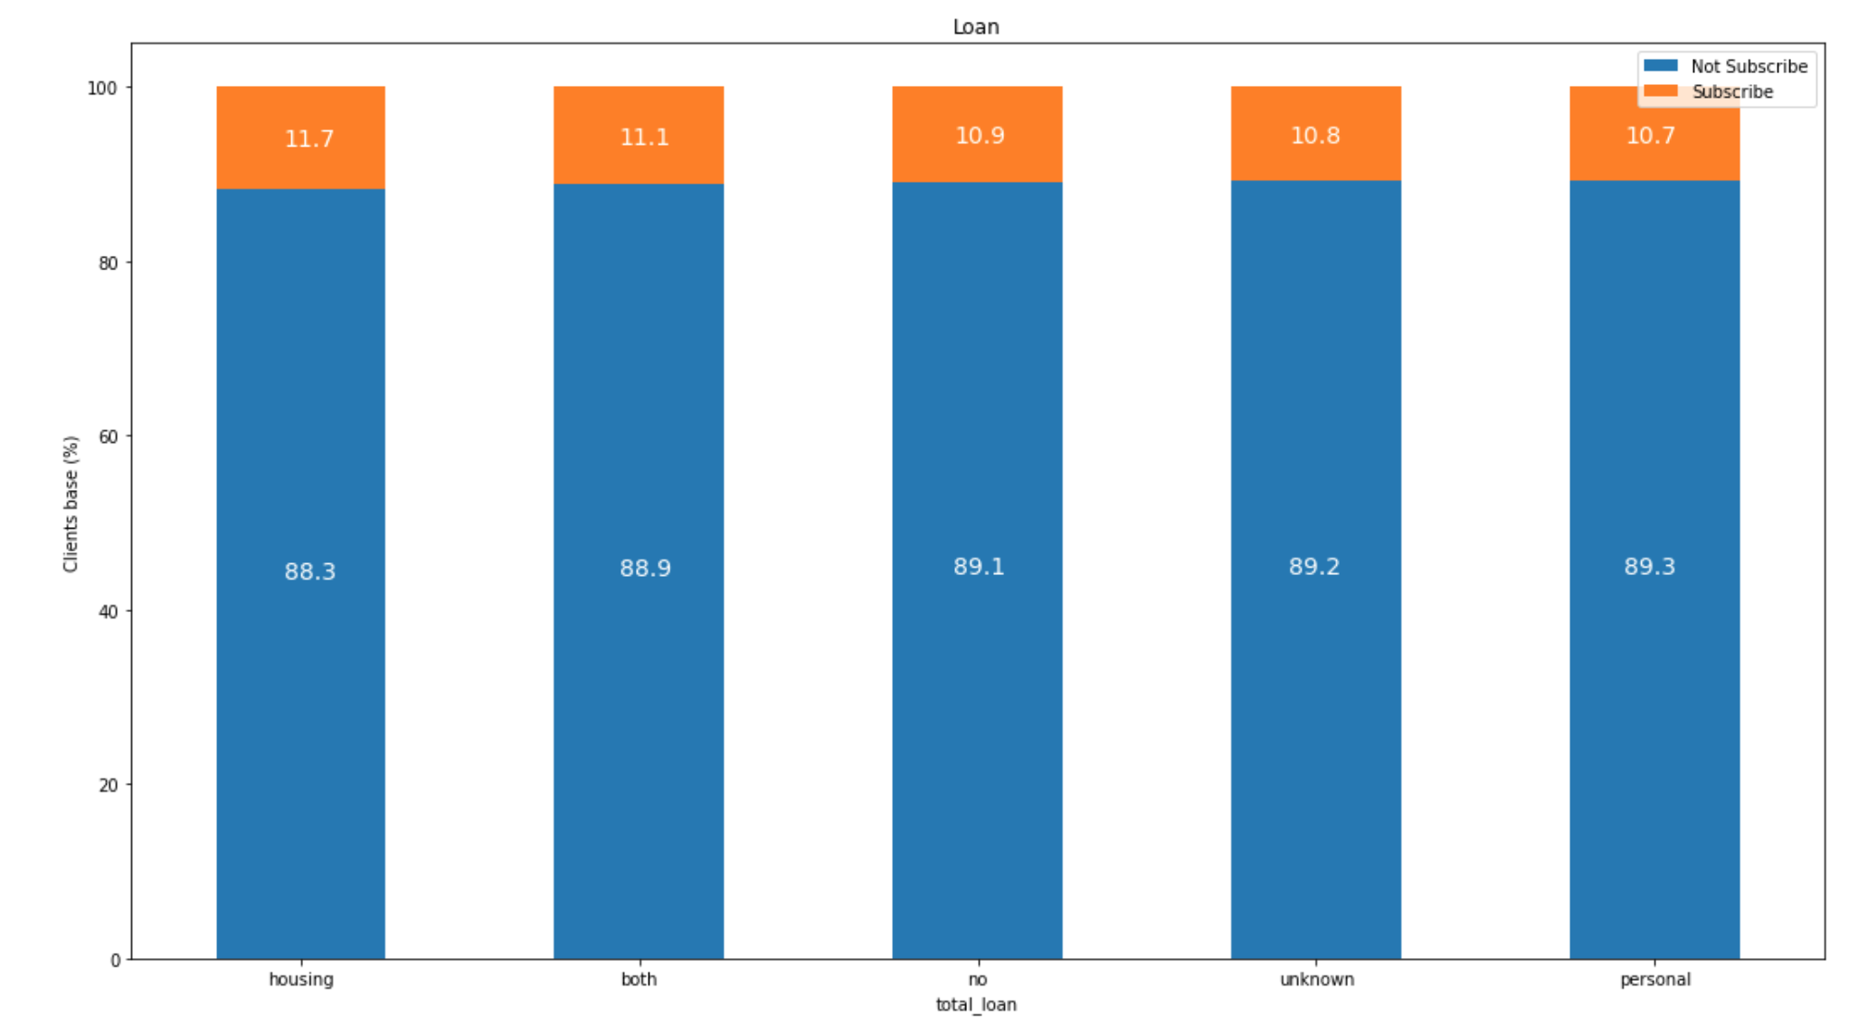

EDA – loan
Not too much difference in housing or personal loan clients or both

Slide 11
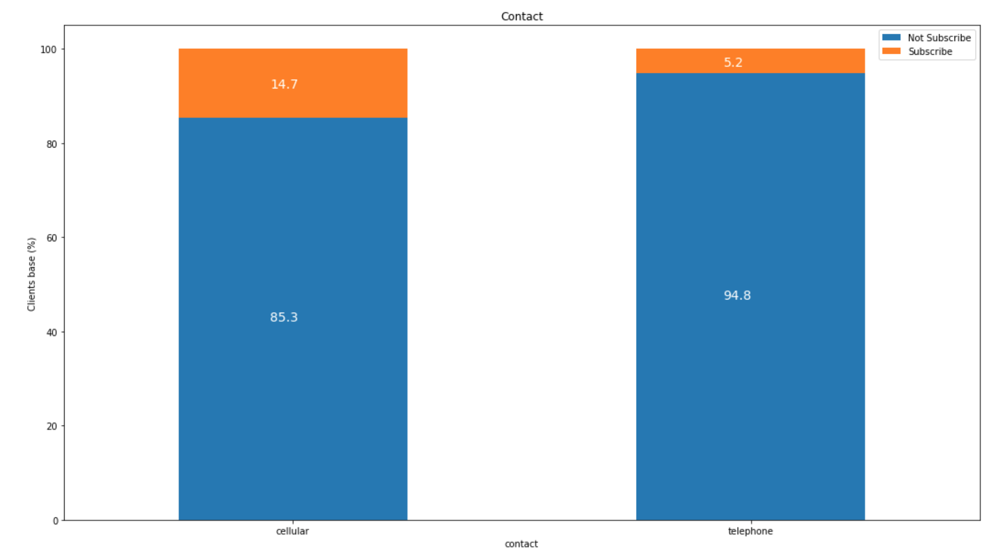
EDA – contact
clients who contacted with cellular are more likely to subscribe
probably because when calling telephone, people are not around

Slide 12
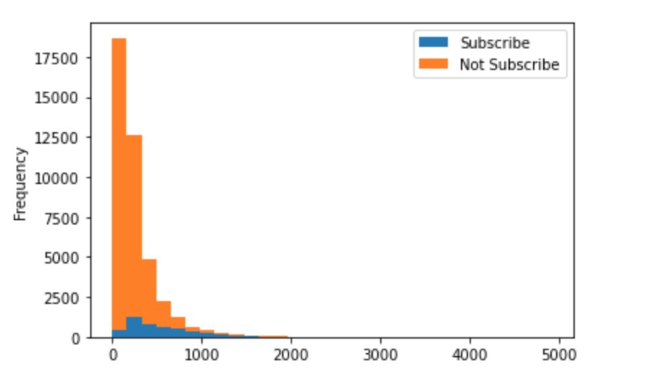
EDA – duration
this attribute highly affects the output target (e.g., if duration=0 then y='no'). Yet, the duration is not known before a call is performed. Also, after the end of the call y is obviously known. should be removed

Slide 13
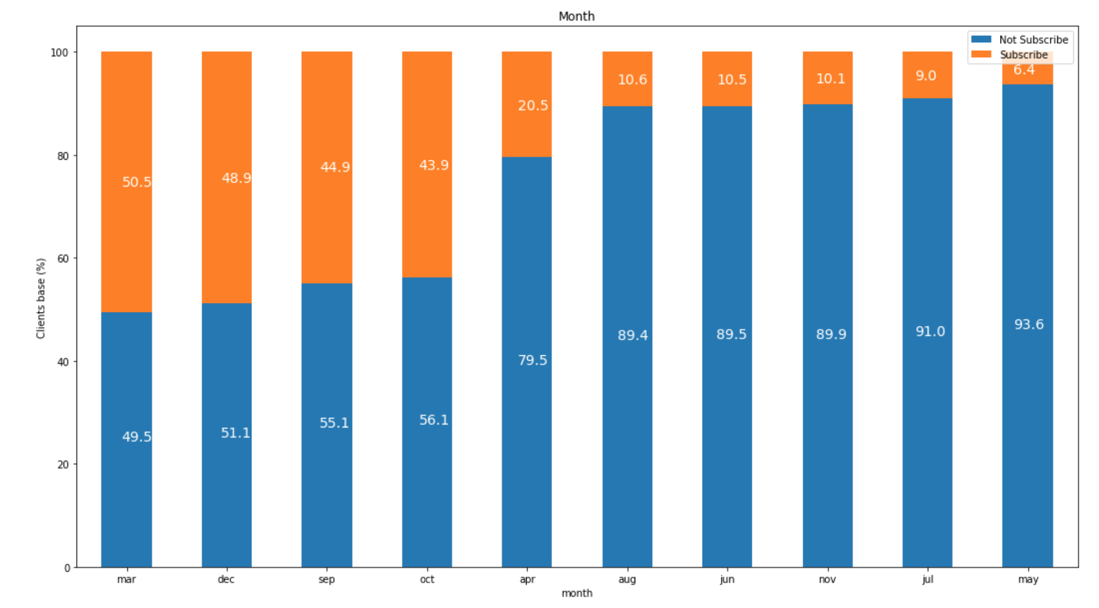
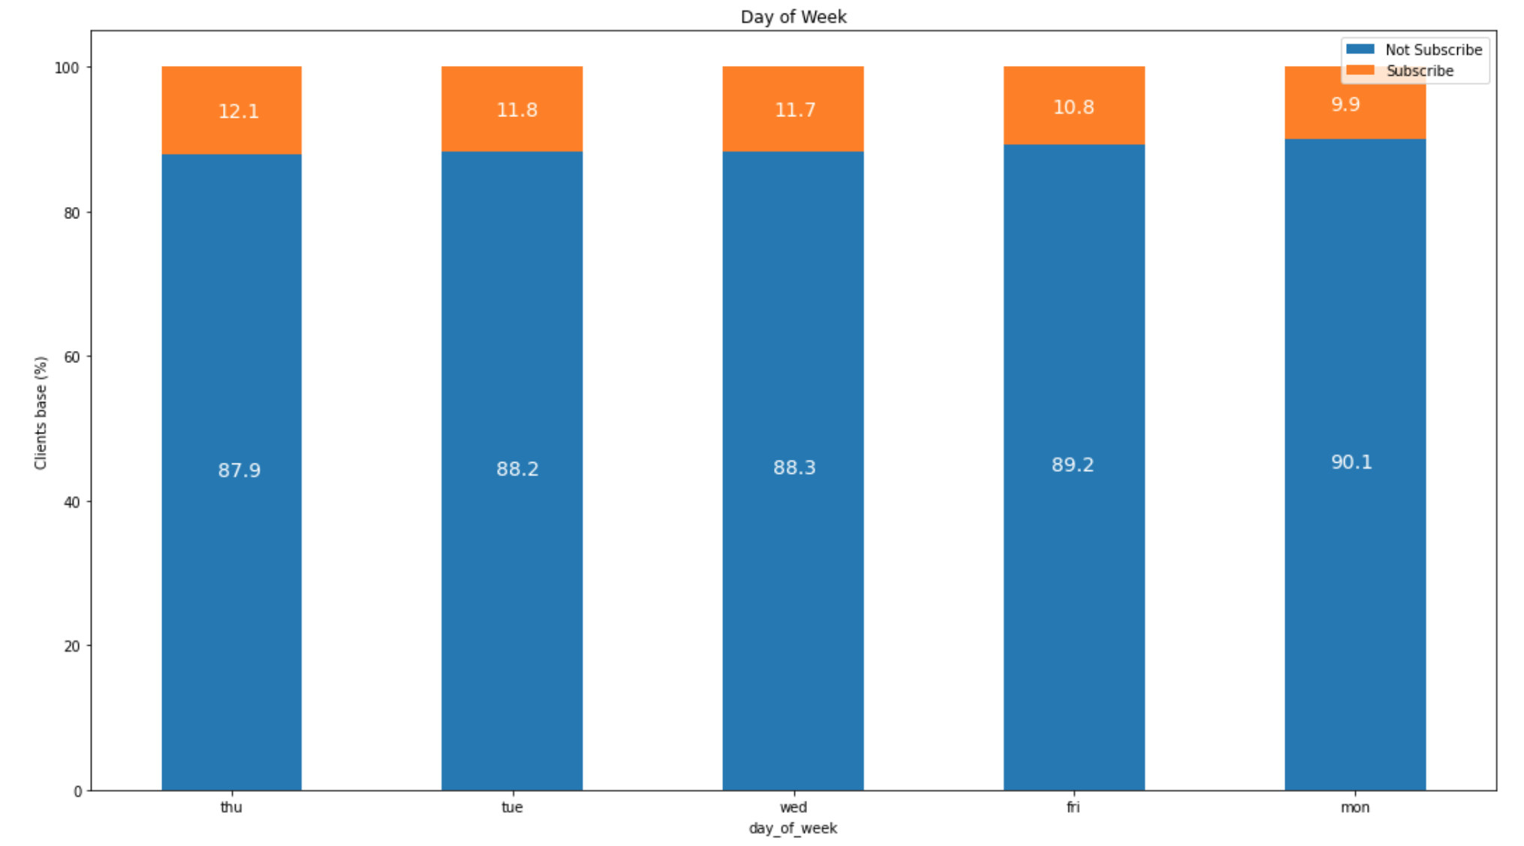
EDA – date
Month:
It looks like there are more subscribers at the beginning (March) and towards the end (Dec., Sep, Oct.) of the year
Not for sure because lacking Jan and Feb.
Day of week:
Not too much difference

Slide 14
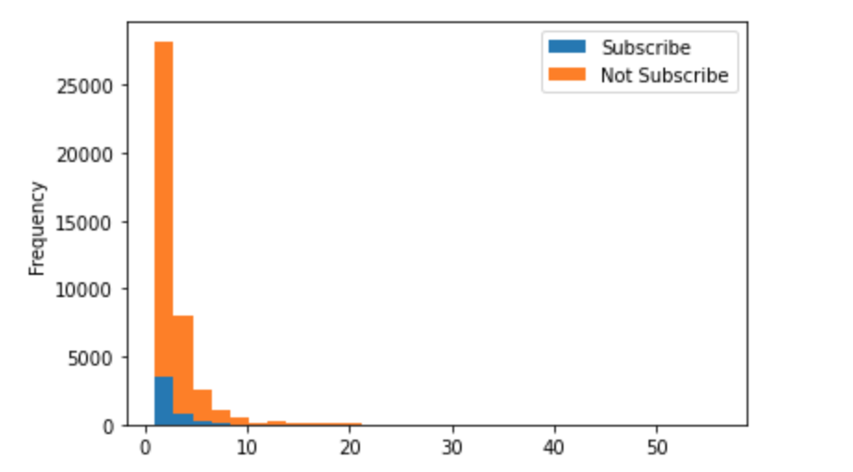
EDA – campaign
lower than subscribe ratio -> more campaign contacted, less subscribe

Slide 15
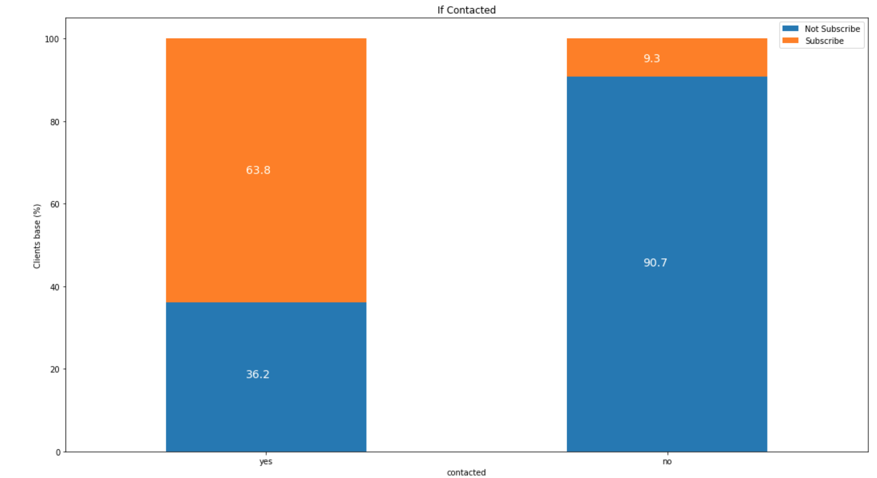
EDA – pdays -> converted to if contacted
Contacted clients would more likely to subscribe

Slide 16
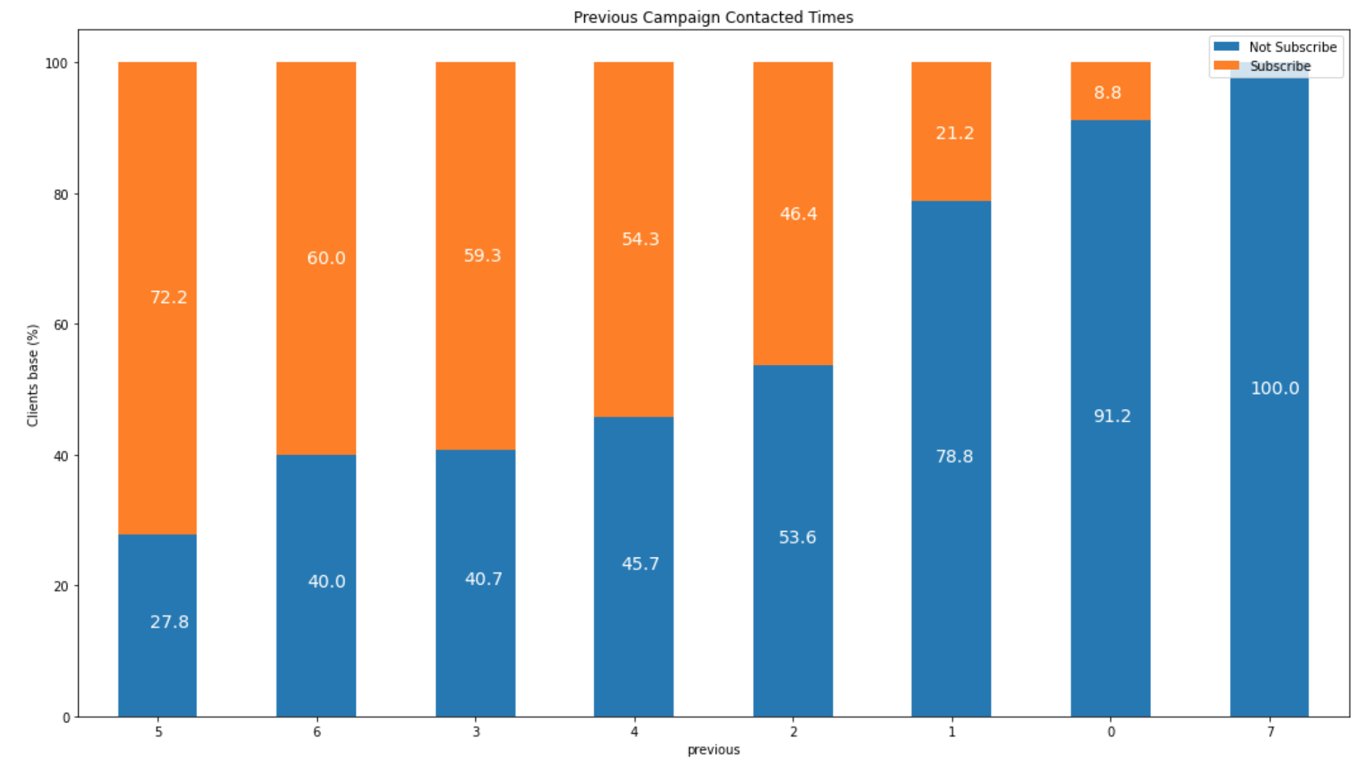
EDA – Previous Campaign Contacted Times
more contacted -> relatively more subscribe

Slide 17
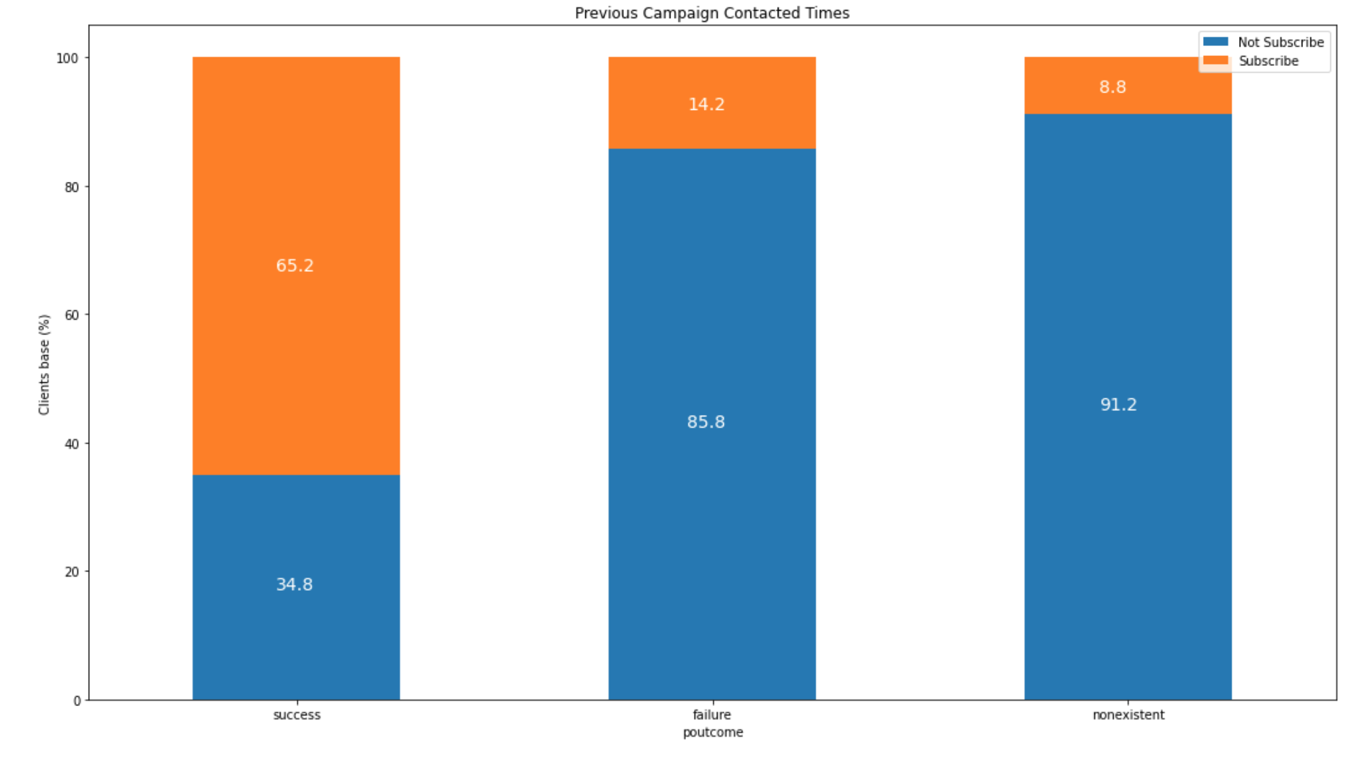
EDA – previous campaign subscription
Clients who attended last campaign are more likely to subscribe

Slide 18
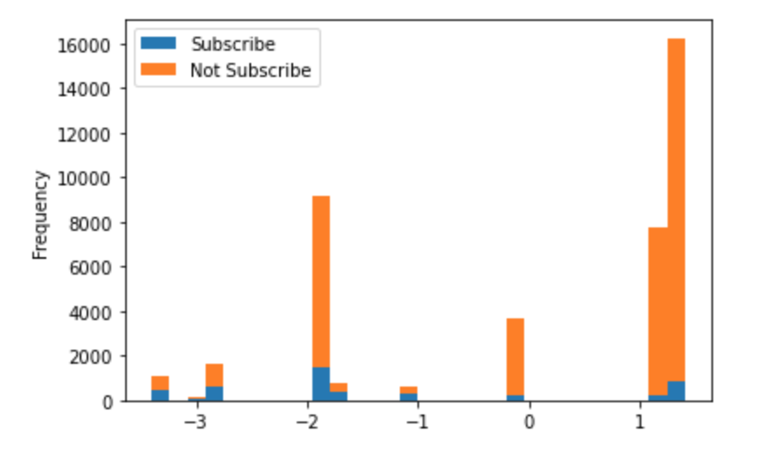
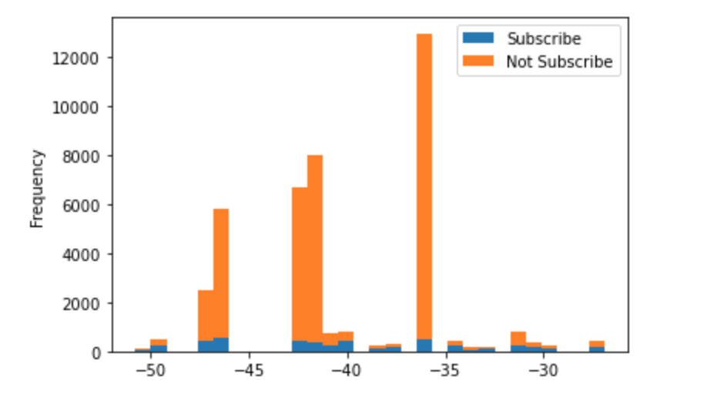
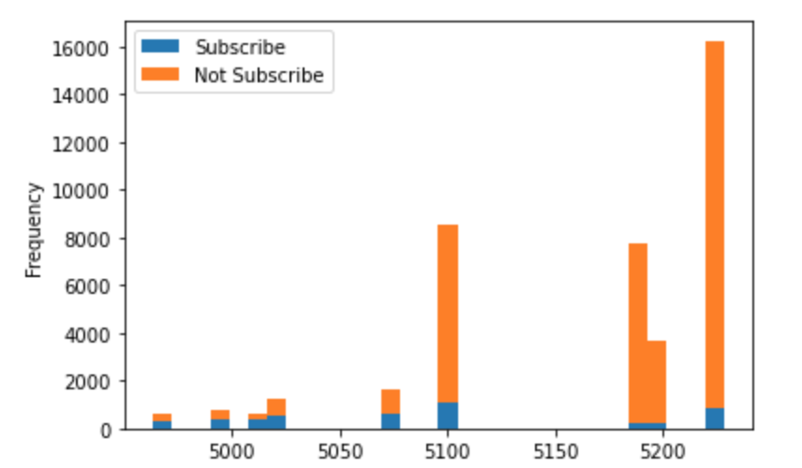
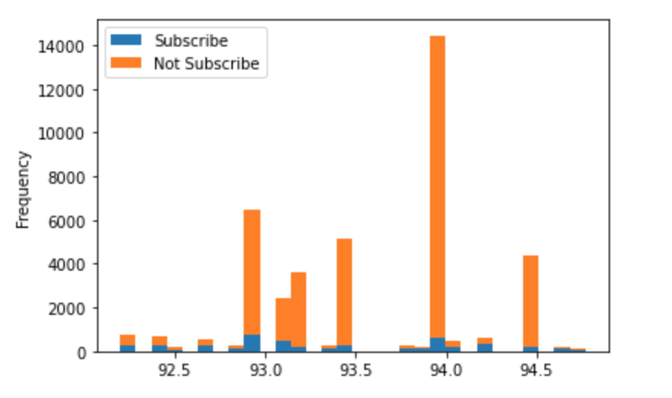
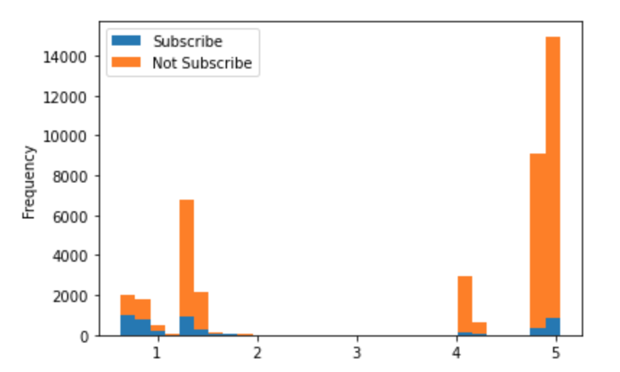
EDA – social and economic context attributes
emp.var.rate
cons.conf.idx
nr.employed
cons.price.idx
euribor
why number of employee was float?
looks like less nr.employed yields more subscribe

Slide 19
Youth and Elder (students and retired) are more likely to subscribe
unknown, single > married, divorced
higher education level yield higher rate of subscription
No credits default > yes (but only 3 people)
loan, regardless personal or housing, has no much influence on the subscribe
clients who contacted with cellular are more likely to subscribe, probably because when calling telephone, people are not around
There are more subscribers at the beginning (March) and towards the end (Dec., Sep, Oct.) of the year, but no much difference based on each day of week
lower than subscribe ratio -> more contacted in this campaign, less subscribe
Client who was last contacted subscribe more, the more contacts performed before this campaign, the more chance the clients will subscribe and clients who attended last campaign are more likely to subscribe
EDA Conclusion

Slide 20
Feature Engineering
Removed unrelated variables
'loan', 'housing', 'total_loan', 'day_of_week'
Skewed variables
`campaign` and `previous` -> log transformation
Create dummy variables
'job', 'marital', 'education', 'default', 'contact', 'month', 'poutcome', 'agerange', 'contacted'
Dealing with correlation variables
Remove ‘emp.var.rate‘ with high correlation with many other features
Imbalanced data
Used random resampling and SMOTE technology

Slide 21
Modeling
Comparing with different resampling methods performance, overall SMOTE method highly increased the test accuracy of logistic regression and ANN model, while SMOTE method slightly decreased the accuracy of random forest model
Due the bagging method and better performance, the random forest model with random resampling method was chosen to be the model for use
 | Logistic Regression | Random Forest | ANN
Resampling | 73.48% | 94.91% | 72.95%
SMOTE | 89.22% | 92.98% | 88.09%

Slide 22
Conclusion
Random forest model successfully predicted around 95% accuracy for the clients’ subscription of banking campaign
Clients’ subscription is more related to their last time performance, the more they were contacted, more chance to subscribe. Thus, the stuff could increase customer engagement by strengthening contact with customers, especially via cellular.
For people with low subscription rate, such as middle-aged people, low education, etc., you can offer appropriate discounts to increase the subscription rate

